Slide 1
Nifty 50 EDA
Made by: Dipesh Bindlish
UID: 21MCA2304
Class: Elite-1

Slide 2
NIFTY 50
The NIFTY 50 is a benchmark Indian stock market index that represents the weighted average of 50 of the largest Indian companies listed on the National Stock Exchange.
This project is based on the data from 2001 to 2021.

Slide 3
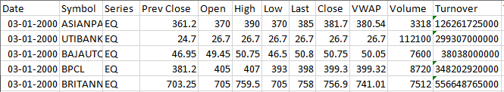
NIFTY 50 Dataset
This is the sample of first 5 rows of the dataset.
It includes Date, Symbol of the companies, their Opening, Closing price on a certain date, etc.

Slide 4
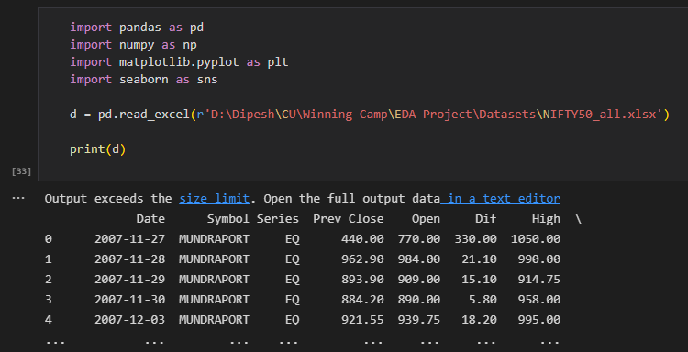
Importing Data set & libraries

Slide 5
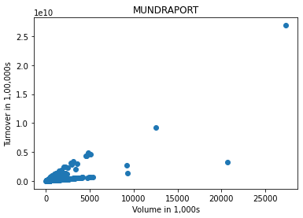
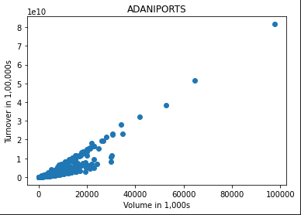
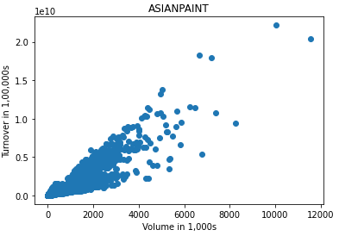
Scatter Plot to show coorelation between Volume & Turnover for various stocks in Nifty 50 over the years.

Slide 6
As most of the plots are making a straight line with 45° angle, so volume & turnover have a positive coorelation near to 1. To support the above statement below is the coorelation plot for the same.

Slide 7
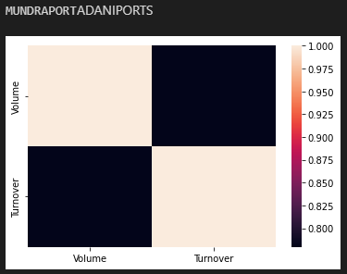
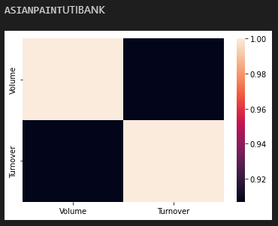
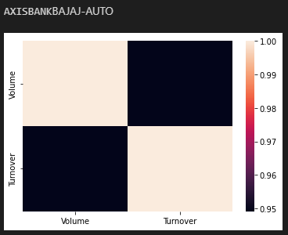
Coorelation Plots

Slide 8
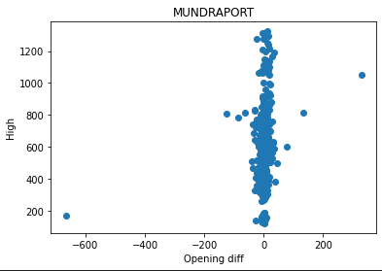
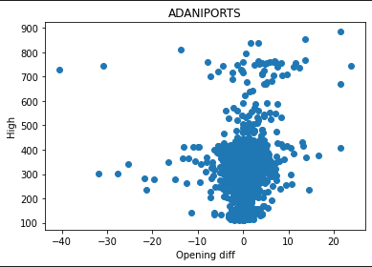
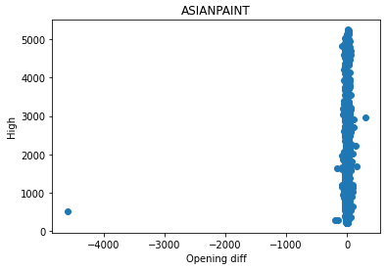
Scatter Plot to show the effect of difference in opening price on the high of that day for various stocks in Nifty 50 over the years.

Slide 9
To study the above grapths we have to ignore the plots where difference is near to zero. Also, here correlation plot will fail to show any result. So, in below plots the difference of 10% or less is deleted & then plotting is done.

Slide 10
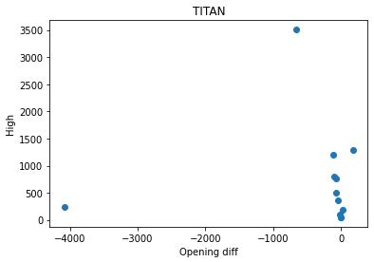
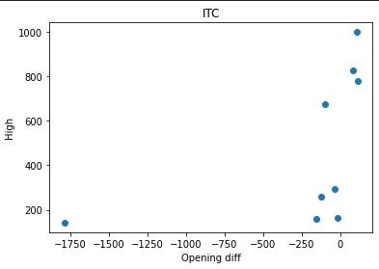
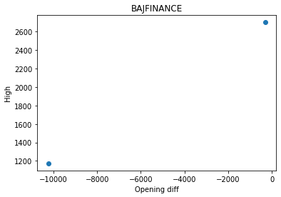
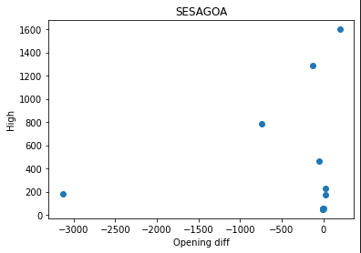
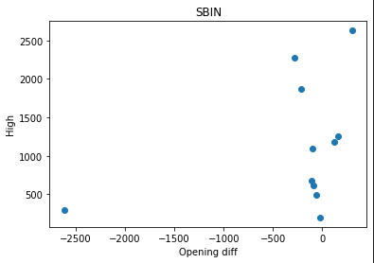
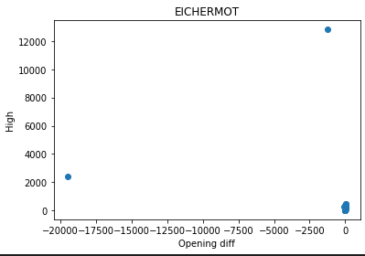
Scatter Plot 2

Slide 11
Thank You

